Slide 1
INFO20003 Database Systems
Kuoyuan Li
Tutorial 12

Slide 2
Agenda
Understand the concepts of NoSQL databases
Choosing appropriate NoSQL database types for scenarios
CAP theorem with respect to NoSQL databases
Revision
Notes:
What does this data growth imply? It implies that finding useful information is equal to….

Slide 3
Understand the concepts of NoSQL databases
1. NoSQL database
Non-relational database
Help store and retrieve data in formats other than tabular form
Not depend on any particular structure such as tables, rows, columns or schemas to organize data
Notes:
Today data is incorporated in our aspects of our lives. Just think of your daily actions… examples…
And on top of it there is this big business of extracting value from the data - call it business analytics, data driven decision making – anything you like, the point is to extract the hidden cold stored in this data
- Think of amazon recommended products, Netflix movies to watch.. All this is driven by your actions and the data you generate
Data exhaust
44 zb by 2020 digital universe
To put things in perspective 1 zb when it is burn on stack of cds it would be 4.1 million km high – which is high enough to reach from the earth to the moon and back 5 times

Slide 4
Understand the concepts of NoSQL databases
1. NoSQL database
Why need it?
We want intensive but flexible data analysis using distributed systems, cloud computing and high-performance computing (HPC)
Traditional relational databases are unable to meet performance, scalability and flexibility requirements.
Examples: chat data, messaging, large objects such as videos and images and many types of business documents.
Notes:
Today data is incorporated in our aspects of our lives. Just think of your daily actions… examples…
And on top of it there is this big business of extracting value from the data - call it business analytics, data driven decision making – anything you like, the point is to extract the hidden cold stored in this data
- Think of amazon recommended products, Netflix movies to watch.. All this is driven by your actions and the data you generate
Data exhaust
44 zb by 2020 digital universe
To put things in perspective 1 zb when it is burn on stack of cds it would be 4.1 million km high – which is high enough to reach from the earth to the moon and back 5 times

Slide 5
Understand the concepts of NoSQL databases
1. Type of NoSQL database
a. Graph databases:
Based on graph theory and utilize the concept of a graph to store, connect and query data.
Nodes: rows or records in the relational database and represent entities such as accounts, people, items etc.
Edges: connect nodes and resemble the relational relationship between tables. Both nodes and edges can have properties associated with them.
Examples: neo4j, used by Airbnb, Microsoft, IBM, eBay and Walmart.
Notes:
Today data is incorporated in our aspects of our lives. Just think of your daily actions… examples…
And on top of it there is this big business of extracting value from the data - call it business analytics, data driven decision making – anything you like, the point is to extract the hidden cold stored in this data
- Think of amazon recommended products, Netflix movies to watch.. All this is driven by your actions and the data you generate
Data exhaust
44 zb by 2020 digital universe
To put things in perspective 1 zb when it is burn on stack of cds it would be 4.1 million km high – which is high enough to reach from the earth to the moon and back 5 times

Slide 6
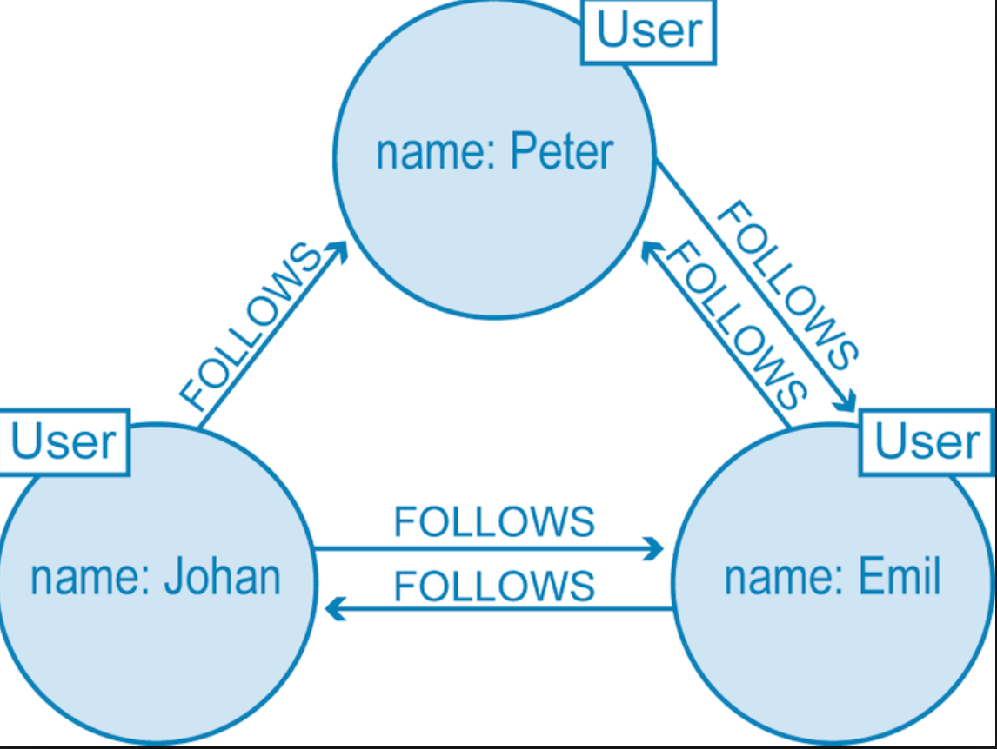
Understand the concepts of NoSQL databases
1. Type of NoSQL database
a. Graph databases:
https://www.google.com/search?q=graph+database&rlz=1C5CHFA_enAU783AU812&source=lnms&tbm=isch&sa=X&ved=0ahUKEwi7hIa_0rviAhUF_XMBHaYZAQoQ_AUIDigB&biw=1440&bih=716#imgrc=MKmkZXUR5NIEDM:
Notes:
Today data is incorporated in our aspects of our lives. Just think of your daily actions… examples…
And on top of it there is this big business of extracting value from the data - call it business analytics, data driven decision making – anything you like, the point is to extract the hidden cold stored in this data
- Think of amazon recommended products, Netflix movies to watch.. All this is driven by your actions and the data you generate
Data exhaust
44 zb by 2020 digital universe
To put things in perspective 1 zb when it is burn on stack of cds it would be 4.1 million km high – which is high enough to reach from the earth to the moon and back 5 times

Slide 7
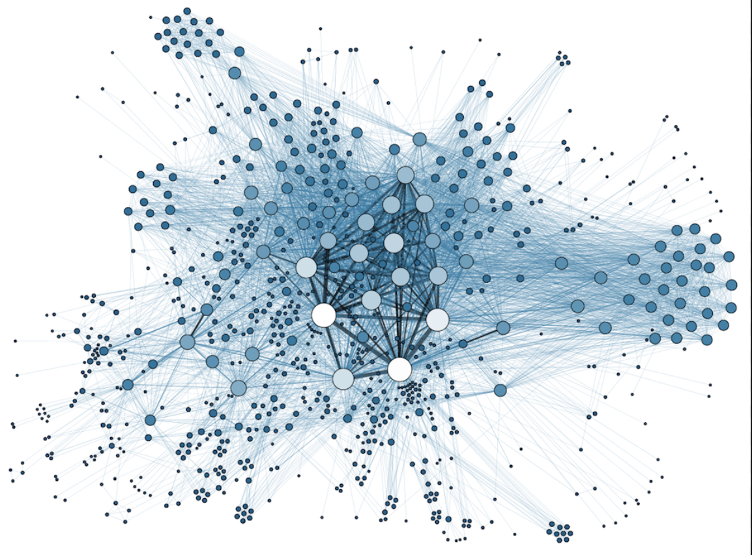
Understand the concepts of NoSQL databases
1. Type of NoSQL database
a. Graph databases:
https://www.google.com/search?q=graph+database&rlz=1C5CHFA_enAU783AU812&source=lnms&tbm=isch&sa=X&ved=0ahUKEwi7hIa_0rviAhUF_XMBHaYZAQoQ_AUIDigB&biw=1440&bih=716#imgrc=ydEvFNq3bjBTQM:
Notes:
Today data is incorporated in our aspects of our lives. Just think of your daily actions… examples…
And on top of it there is this big business of extracting value from the data - call it business analytics, data driven decision making – anything you like, the point is to extract the hidden cold stored in this data
- Think of amazon recommended products, Netflix movies to watch.. All this is driven by your actions and the data you generate
Data exhaust
44 zb by 2020 digital universe
To put things in perspective 1 zb when it is burn on stack of cds it would be 4.1 million km high – which is high enough to reach from the earth to the moon and back 5 times

Slide 8
Understand the concepts of NoSQL databases
1. Type of NoSQL database
b. Key-value stores:
Most flexible NoSQL databases
Least structured
Use a simple key-value structure to organize data
No schema
The data values can be of any data type
Key: unique identifier to allow retrieval of the associated value
Value: anything (images, text, videos, binary data, lists, JSON)
Examples: Berkeley DB, Aerospike and Redis. Key-value stores are highly flexible and support massive scalability
Notes:
Today data is incorporated in our aspects of our lives. Just think of your daily actions… examples…
And on top of it there is this big business of extracting value from the data - call it business analytics, data driven decision making – anything you like, the point is to extract the hidden cold stored in this data
- Think of amazon recommended products, Netflix movies to watch.. All this is driven by your actions and the data you generate
Data exhaust
44 zb by 2020 digital universe
To put things in perspective 1 zb when it is burn on stack of cds it would be 4.1 million km high – which is high enough to reach from the earth to the moon and back 5 times

Slide 9
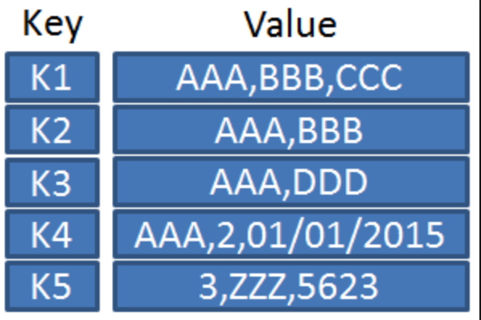
Understand the concepts of NoSQL databases
1. Type of NoSQL database
b. Key-value stores:
https://www.google.com/search?q=key+value+store&rlz=1C5CHFA_enAU783AU812&source=lnms&tbm=isch&sa=X&ved=0ahUKEwjEyrSg07viAhUkjOYKHYknCwgQ_AUIDigB&biw=1440&bih=716#imgrc=21g0eFT_9EdOmM:
Notes:
Today data is incorporated in our aspects of our lives. Just think of your daily actions… examples…
And on top of it there is this big business of extracting value from the data - call it business analytics, data driven decision making – anything you like, the point is to extract the hidden cold stored in this data
- Think of amazon recommended products, Netflix movies to watch.. All this is driven by your actions and the data you generate
Data exhaust
44 zb by 2020 digital universe
To put things in perspective 1 zb when it is burn on stack of cds it would be 4.1 million km high – which is high enough to reach from the earth to the moon and back 5 times

Slide 10
Understand the concepts of NoSQL databases
1. Type of NoSQL database
c. Column-family stores:
A type of key-value database
Use tables, rows and columns but for each record the column names, their format and record keys can greatly vary
Semi-structured data
Columns: created for each row instead of being predefined
Examples: Cassandra and Hbase used by Facebook in the past to handle messaging and inbox search. Other enterprises using wide column stores are Netflix, Twitter and Reddit
Notes:
Today data is incorporated in our aspects of our lives. Just think of your daily actions… examples…
And on top of it there is this big business of extracting value from the data - call it business analytics, data driven decision making – anything you like, the point is to extract the hidden cold stored in this data
- Think of amazon recommended products, Netflix movies to watch.. All this is driven by your actions and the data you generate
Data exhaust
44 zb by 2020 digital universe
To put things in perspective 1 zb when it is burn on stack of cds it would be 4.1 million km high – which is high enough to reach from the earth to the moon and back 5 times

Slide 11
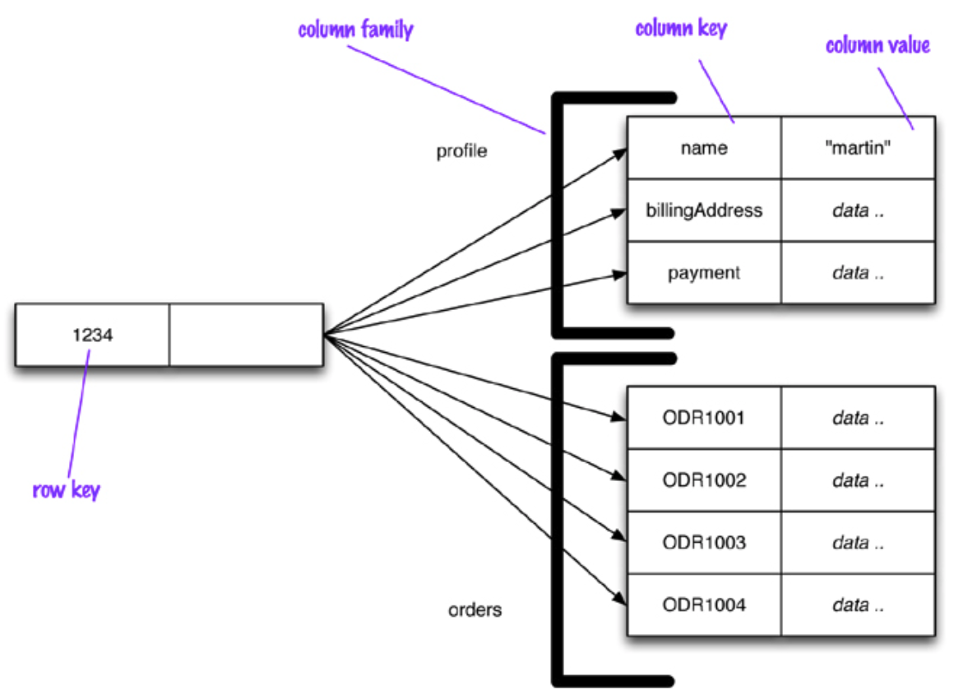
Understand the concepts of NoSQL databases
1. Type of NoSQL database
c. Column-
family stores:
https://www.google.com/search?q=column+family+store&rlz=1C5CHFA_enAU783AU812&source=lnms&tbm=isch&sa=X&ved=0ahUKEwiIg4i707viAhXx8XMBHWuCAY8Q_AUIDigB&biw=1440&bih=716#imgrc=vktlPkW8D7CQeM:
Notes:
Today data is incorporated in our aspects of our lives. Just think of your daily actions… examples…
And on top of it there is this big business of extracting value from the data - call it business analytics, data driven decision making – anything you like, the point is to extract the hidden cold stored in this data
- Think of amazon recommended products, Netflix movies to watch.. All this is driven by your actions and the data you generate
Data exhaust
44 zb by 2020 digital universe
To put things in perspective 1 zb when it is burn on stack of cds it would be 4.1 million km high – which is high enough to reach from the earth to the moon and back 5 times

Slide 12
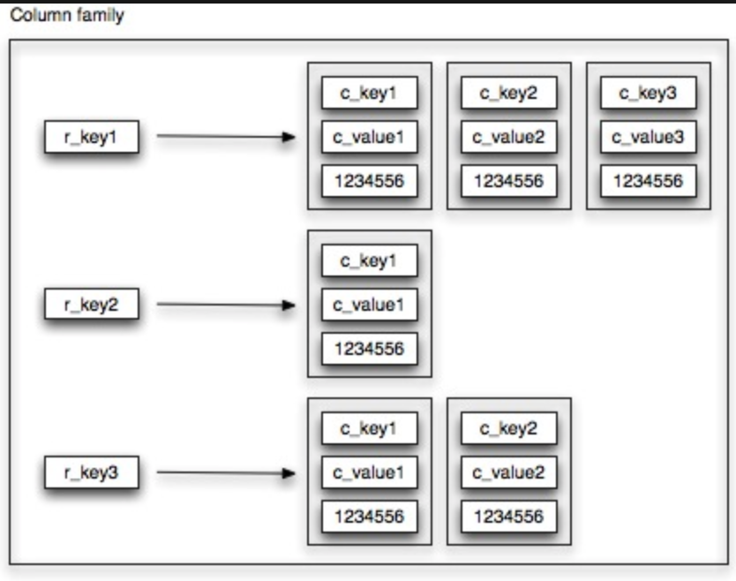
Understand the concepts of NoSQL databases
1. Type of NoSQL database
c. Column-family stores:
https://www.google.com/search?q=column+family+store&rlz=1C5CHFA_enAU783AU812&source=lnms&tbm=isch&sa=X&ved=0ahUKEwiIg4i707viAhXx8XMBHWuCAY8Q_AUIDigB&biw=1440&bih=716#imgrc=hR5i4LaD5DW0SM:
Notes:
Today data is incorporated in our aspects of our lives. Just think of your daily actions… examples…
And on top of it there is this big business of extracting value from the data - call it business analytics, data driven decision making – anything you like, the point is to extract the hidden cold stored in this data
- Think of amazon recommended products, Netflix movies to watch.. All this is driven by your actions and the data you generate
Data exhaust
44 zb by 2020 digital universe
To put things in perspective 1 zb when it is burn on stack of cds it would be 4.1 million km high – which is high enough to reach from the earth to the moon and back 5 times

Slide 13
Understand the concepts of NoSQL databases
1. Type of NoSQL database
d. Document stores
Store data in JSON, XML or BSON documents (where JSON is by far the most dominant).
Resulting documents are independent components which can be distributed more easily
Each document can have its own structure and schema
Still possible to create indexes within documents
Examples: MongoDB
Notes:
Today data is incorporated in our aspects of our lives. Just think of your daily actions… examples…
And on top of it there is this big business of extracting value from the data - call it business analytics, data driven decision making – anything you like, the point is to extract the hidden cold stored in this data
- Think of amazon recommended products, Netflix movies to watch.. All this is driven by your actions and the data you generate
Data exhaust
44 zb by 2020 digital universe
To put things in perspective 1 zb when it is burn on stack of cds it would be 4.1 million km high – which is high enough to reach from the earth to the moon and back 5 times

Slide 14
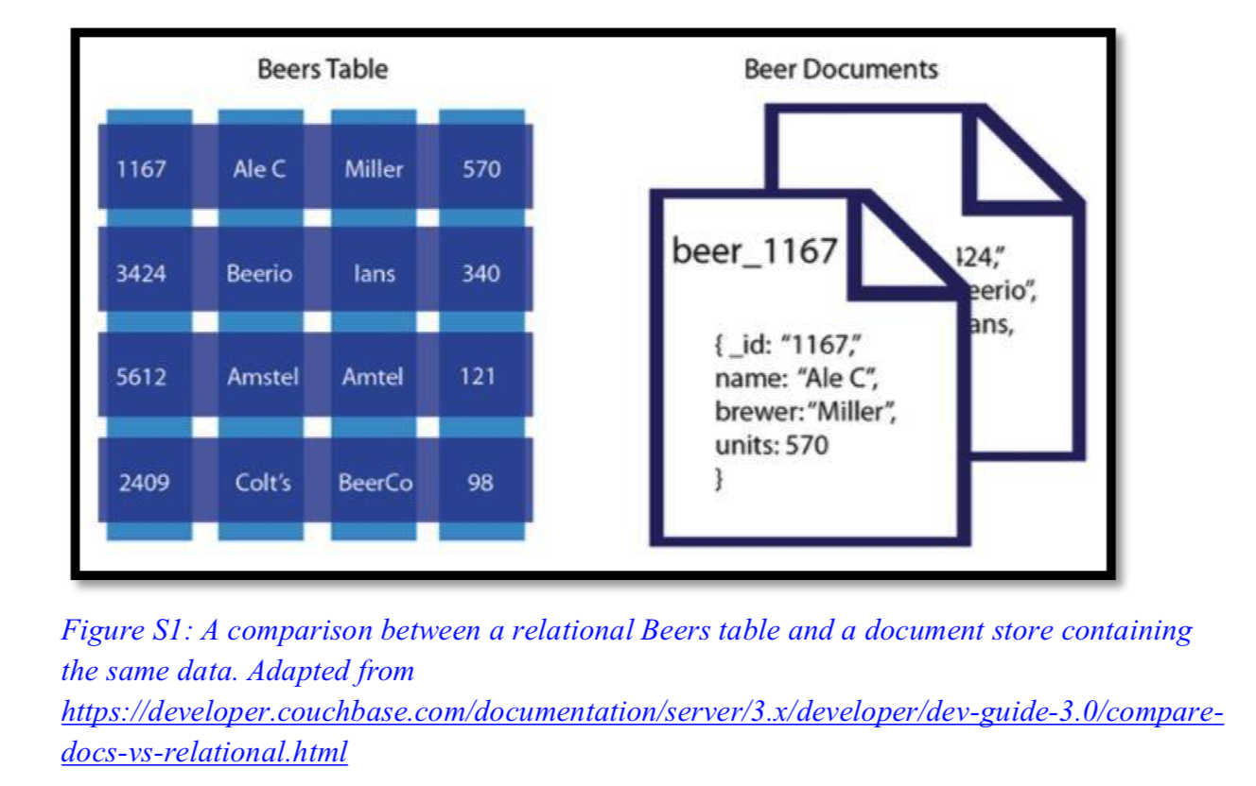
Understand the concepts of NoSQL databases
1. Type of NoSQL database
d. Document stores
Notes:
Today data is incorporated in our aspects of our lives. Just think of your daily actions… examples…
And on top of it there is this big business of extracting value from the data - call it business analytics, data driven decision making – anything you like, the point is to extract the hidden cold stored in this data
- Think of amazon recommended products, Netflix movies to watch.. All this is driven by your actions and the data you generate
Data exhaust
44 zb by 2020 digital universe
To put things in perspective 1 zb when it is burn on stack of cds it would be 4.1 million km high – which is high enough to reach from the earth to the moon and back 5 times

Slide 15
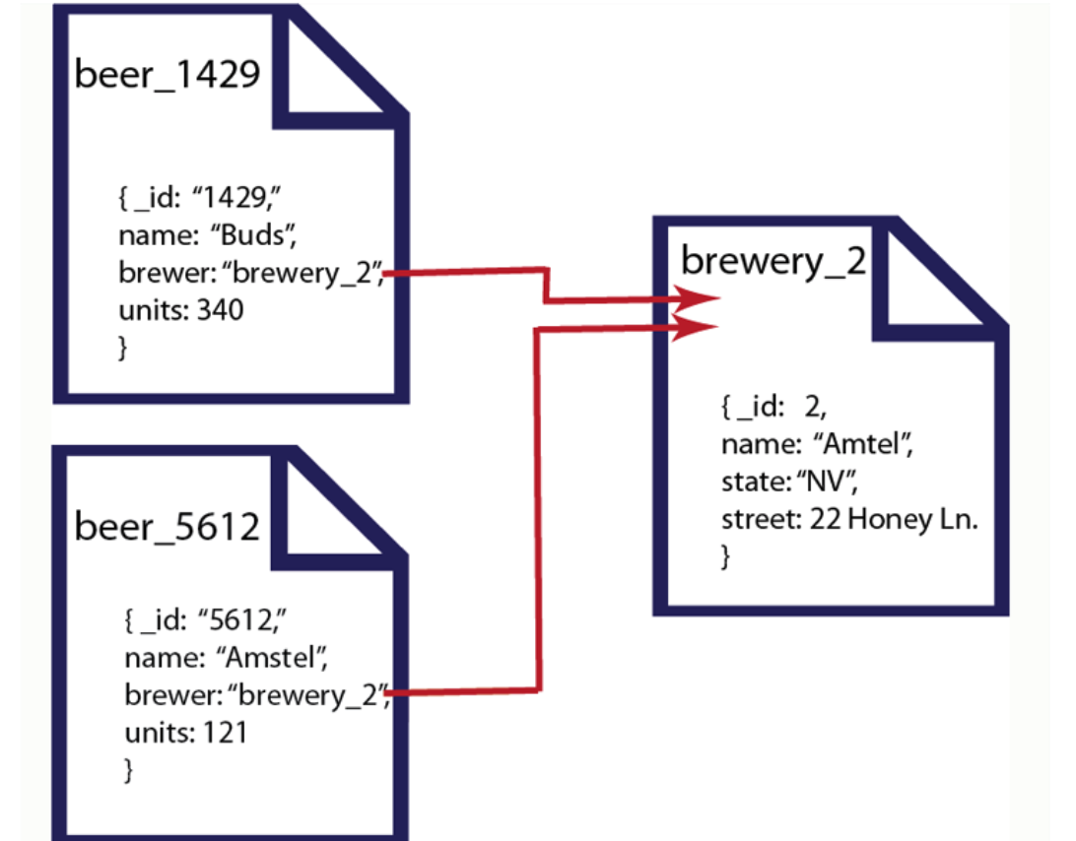
Understand the concepts of NoSQL databases
1. Type of NoSQL database
d. Document stores
https://www.google.com/search?q=document+store&rlz=1C5CHFA_enAU783AU812&source=lnms&tbm=isch&sa=X&ved=0ahUKEwjZgsb807viAhURU30KHZHRCskQ_AUIDigB&biw=1440&bih=716&dpr=2#imgrc=rFDJBRFS9hyDGM:
Notes:
Today data is incorporated in our aspects of our lives. Just think of your daily actions… examples…
And on top of it there is this big business of extracting value from the data - call it business analytics, data driven decision making – anything you like, the point is to extract the hidden cold stored in this data
- Think of amazon recommended products, Netflix movies to watch.. All this is driven by your actions and the data you generate
Data exhaust
44 zb by 2020 digital universe
To put things in perspective 1 zb when it is burn on stack of cds it would be 4.1 million km high – which is high enough to reach from the earth to the moon and back 5 times

Slide 16
Understand the concepts of NoSQL databases
Any questions?
Notes:
Today data is incorporated in our aspects of our lives. Just think of your daily actions… examples…
And on top of it there is this big business of extracting value from the data - call it business analytics, data driven decision making – anything you like, the point is to extract the hidden cold stored in this data
- Think of amazon recommended products, Netflix movies to watch.. All this is driven by your actions and the data you generate
Data exhaust
44 zb by 2020 digital universe
To put things in perspective 1 zb when it is burn on stack of cds it would be 4.1 million km high – which is high enough to reach from the earth to the moon and back 5 times

Slide 17
Choosing appropriate NoSQL database types for scenarios
1. Choosing a NoSQL database
Libraries store information about their collections in their catalogue.
Match each of the following statements to the type of NoSQL database that would be best for storing that library’s data. Select from the four types of NoSQL database discussed previously.
Notes:
Today data is incorporated in our aspects of our lives. Just think of your daily actions… examples…
And on top of it there is this big business of extracting value from the data - call it business analytics, data driven decision making – anything you like, the point is to extract the hidden cold stored in this data
- Think of amazon recommended products, Netflix movies to watch.. All this is driven by your actions and the data you generate
Data exhaust
44 zb by 2020 digital universe
To put things in perspective 1 zb when it is burn on stack of cds it would be 4.1 million km high – which is high enough to reach from the earth to the moon and back 5 times

Slide 18
Choosing appropriate NoSQL database types for scenarios
1. Choosing a NoSQL database
Libraries store information about their collections in their catalogue.
Match each of the following statements to the type of NoSQL database that would be best for storing that library’s data. Select from the four types of NoSQL database discussed previously.
a. In one library, items are catalogued by author, title and publisher, as well as any number of other fields chosen by the cataloguer, such as physical description, subject codes and notes.
Notes:
Today data is incorporated in our aspects of our lives. Just think of your daily actions… examples…
And on top of it there is this big business of extracting value from the data - call it business analytics, data driven decision making – anything you like, the point is to extract the hidden cold stored in this data
- Think of amazon recommended products, Netflix movies to watch.. All this is driven by your actions and the data you generate
Data exhaust
44 zb by 2020 digital universe
To put things in perspective 1 zb when it is burn on stack of cds it would be 4.1 million km high – which is high enough to reach from the earth to the moon and back 5 times

Slide 19
Choosing appropriate NoSQL database types for scenarios
1. Choosing a NoSQL database
Libraries store information about their collections in their catalogue.
Match each of the following statements to the type of NoSQL database that would be best for storing that library’s data. Select from the four types of NoSQL database discussed previously.
a. In one library, items are catalogued by author, title and publisher, as well as any number of other fields chosen by the cataloguer, such as physical description, subject codes and notes.
A column-family database would be the best choice. Each row (each item) in a column-family table may have a different set of columns associated with it.
Notes:
Today data is incorporated in our aspects of our lives. Just think of your daily actions… examples…
And on top of it there is this big business of extracting value from the data - call it business analytics, data driven decision making – anything you like, the point is to extract the hidden cold stored in this data
- Think of amazon recommended products, Netflix movies to watch.. All this is driven by your actions and the data you generate
Data exhaust
44 zb by 2020 digital universe
To put things in perspective 1 zb when it is burn on stack of cds it would be 4.1 million km high – which is high enough to reach from the earth to the moon and back 5 times

Slide 20
Choosing appropriate NoSQL database types for scenarios
1. Choosing a NoSQL database
Libraries store information about their collections in their catalogue.
Match each of the following statements to the type of NoSQL database that would be best for storing that library’s data. Select from the four types of NoSQL database discussed previously.
b. In another library, each catalogue record is stored in the MARC format (Figure 1), a coded text format that contains all the catalogue information for a particular item.
Notes:
Today data is incorporated in our aspects of our lives. Just think of your daily actions… examples…
And on top of it there is this big business of extracting value from the data - call it business analytics, data driven decision making – anything you like, the point is to extract the hidden cold stored in this data
- Think of amazon recommended products, Netflix movies to watch.. All this is driven by your actions and the data you generate
Data exhaust
44 zb by 2020 digital universe
To put things in perspective 1 zb when it is burn on stack of cds it would be 4.1 million km high – which is high enough to reach from the earth to the moon and back 5 times

Slide 21
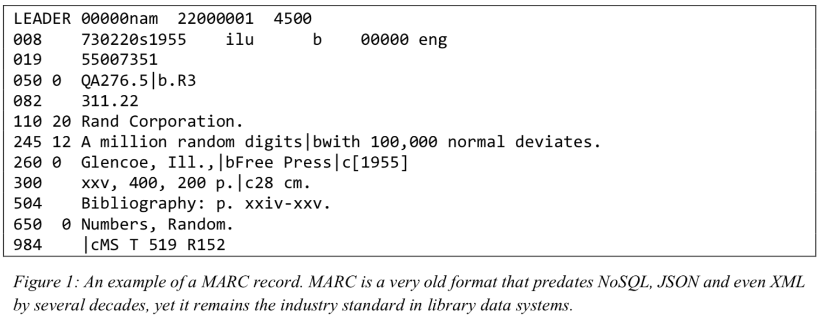
Choosing appropriate NoSQL database types for scenarios
1. Choosing a NoSQL database
Libraries store information about their collections in their catalogue.
Match each of the following statements to the type of NoSQL database that would be best for storing that library’s data. Select from the four types of NoSQL database discussed previously.
b. In another library, each catalogue record is stored in the MARC format (Figure 1), a coded text format that contains all the catalogue information for a particular item.
Notes:
Today data is incorporated in our aspects of our lives. Just think of your daily actions… examples…
And on top of it there is this big business of extracting value from the data - call it business analytics, data driven decision making – anything you like, the point is to extract the hidden cold stored in this data
- Think of amazon recommended products, Netflix movies to watch.. All this is driven by your actions and the data you generate
Data exhaust
44 zb by 2020 digital universe
To put things in perspective 1 zb when it is burn on stack of cds it would be 4.1 million km high – which is high enough to reach from the earth to the moon and back 5 times

Slide 22
Choosing appropriate NoSQL database types for scenarios
1. Choosing a NoSQL database
Libraries store information about their collections in their catalogue.
Match each of the following statements to the type of NoSQL database that would be best for storing that library’s data. Select from the four types of NoSQL database discussed previously.
b. In another library, each catalogue record is stored in the MARC format (Figure 1), a coded text format that contains all the catalogue information for a particular item.
Notes:
Today data is incorporated in our aspects of our lives. Just think of your daily actions… examples…
And on top of it there is this big business of extracting value from the data - call it business analytics, data driven decision making – anything you like, the point is to extract the hidden cold stored in this data
- Think of amazon recommended products, Netflix movies to watch.. All this is driven by your actions and the data you generate
Data exhaust
44 zb by 2020 digital universe
To put things in perspective 1 zb when it is burn on stack of cds it would be 4.1 million km high – which is high enough to reach from the earth to the moon and back 5 times

Slide 23
Choosing appropriate NoSQL database types for scenarios
1. Choosing a NoSQL database
Libraries store information about their collections in their catalogue.
Match each of the following statements to the type of NoSQL database that would be best for storing that library’s data. Select from the four types of NoSQL database discussed previously.
b. In another library, each catalogue record is stored in the MARC format (Figure 1), a coded text format that contains all the catalogue information for a particular item.
A document store would be best suited to this task. Normally, document stores use a modern data interchange format such as JSON or XML, but industry-specific structured data formats such as MARC can be used with specialised document store systems.
Notes:
Today data is incorporated in our aspects of our lives. Just think of your daily actions… examples…
And on top of it there is this big business of extracting value from the data - call it business analytics, data driven decision making – anything you like, the point is to extract the hidden cold stored in this data
- Think of amazon recommended products, Netflix movies to watch.. All this is driven by your actions and the data you generate
Data exhaust
44 zb by 2020 digital universe
To put things in perspective 1 zb when it is burn on stack of cds it would be 4.1 million km high – which is high enough to reach from the earth to the moon and back 5 times

Slide 24
Choosing appropriate NoSQL database types for scenarios
1. Choosing a NoSQL database
Libraries store information about their collections in their catalogue.
Match each of the following statements to the type of NoSQL database that would be best for storing that library’s data. Select from the four types of NoSQL database discussed previously.
c. A public library wishes to store cover photos of all its items, which might be in JPEG, PNG or PDF format, or stored as a URL.
Notes:
Today data is incorporated in our aspects of our lives. Just think of your daily actions… examples…
And on top of it there is this big business of extracting value from the data - call it business analytics, data driven decision making – anything you like, the point is to extract the hidden cold stored in this data
- Think of amazon recommended products, Netflix movies to watch.. All this is driven by your actions and the data you generate
Data exhaust
44 zb by 2020 digital universe
To put things in perspective 1 zb when it is burn on stack of cds it would be 4.1 million km high – which is high enough to reach from the earth to the moon and back 5 times

Slide 25
Choosing appropriate NoSQL database types for scenarios
1. Choosing a NoSQL database
Libraries store information about their collections in their catalogue.
Match each of the following statements to the type of NoSQL database that would be best for storing that library’s data. Select from the four types of NoSQL database discussed previously.
c. A public library wishes to store cover photos of all its items, which might be in JPEG, PNG or PDF format, or stored as a URL.
Key-value stores can store any kind of data. Each document in a document store should be made up of structured data – images are not structured data in the same way as JSON, so a document store is a poor choice.
Notes:
Today data is incorporated in our aspects of our lives. Just think of your daily actions… examples…
And on top of it there is this big business of extracting value from the data - call it business analytics, data driven decision making – anything you like, the point is to extract the hidden cold stored in this data
- Think of amazon recommended products, Netflix movies to watch.. All this is driven by your actions and the data you generate
Data exhaust
44 zb by 2020 digital universe
To put things in perspective 1 zb when it is burn on stack of cds it would be 4.1 million km high – which is high enough to reach from the earth to the moon and back 5 times

Slide 26
Choosing appropriate NoSQL database types for scenarios
1. Choosing a NoSQL database
Libraries store information about their collections in their catalogue.
Match each of the following statements to the type of NoSQL database that would be best for storing that library’s data. Select from the four types of NoSQL database discussed previously.
d. A university library wishes to keep track of which published academic papers reference each other in order to help researchers measure their metrics.
Notes:
Today data is incorporated in our aspects of our lives. Just think of your daily actions… examples…
And on top of it there is this big business of extracting value from the data - call it business analytics, data driven decision making – anything you like, the point is to extract the hidden cold stored in this data
- Think of amazon recommended products, Netflix movies to watch.. All this is driven by your actions and the data you generate
Data exhaust
44 zb by 2020 digital universe
To put things in perspective 1 zb when it is burn on stack of cds it would be 4.1 million km high – which is high enough to reach from the earth to the moon and back 5 times

Slide 27
Choosing appropriate NoSQL database types for scenarios
1. Choosing a NoSQL database
Libraries store information about their collections in their catalogue.
Match each of the following statements to the type of NoSQL database that would be best for storing that library’s data. Select from the four types of NoSQL database discussed previously.
d. A university library wishes to keep track of which published academic papers reference each other in order to help researchers measure their metrics.
By storing papers as nodes and references as edges joining the nodes, a graph database can efficiently capture, and answer complex queries about, the relationships between papers.
Notes:
Today data is incorporated in our aspects of our lives. Just think of your daily actions… examples…
And on top of it there is this big business of extracting value from the data - call it business analytics, data driven decision making – anything you like, the point is to extract the hidden cold stored in this data
- Think of amazon recommended products, Netflix movies to watch.. All this is driven by your actions and the data you generate
Data exhaust
44 zb by 2020 digital universe
To put things in perspective 1 zb when it is burn on stack of cds it would be 4.1 million km high – which is high enough to reach from the earth to the moon and back 5 times

Slide 28
Choosing appropriate NoSQL database types for scenarios
Any questions?
Notes:
Today data is incorporated in our aspects of our lives. Just think of your daily actions… examples…
And on top of it there is this big business of extracting value from the data - call it business analytics, data driven decision making – anything you like, the point is to extract the hidden cold stored in this data
- Think of amazon recommended products, Netflix movies to watch.. All this is driven by your actions and the data you generate
Data exhaust
44 zb by 2020 digital universe
To put things in perspective 1 zb when it is burn on stack of cds it would be 4.1 million km high – which is high enough to reach from the earth to the moon and back 5 times

Slide 29
CAP theorem with respect to NoSQL databases
1. Advantages of NoSQL
a. Flexible modelling
Not relying on fixed schema, data types, row size and column name
Flexible data models
More suited to deal with less structured data sources.
b. Scalability
Capacity in a NoSQL database can be added and removed quickly using a horizontal scale-out methodology (adding inexpensive servers and connecting them to a database cluster).
As a result, the cost and complexity associated with scaling up a relational database into a distributed database are avoided.
Notes:
Today data is incorporated in our aspects of our lives. Just think of your daily actions… examples…
And on top of it there is this big business of extracting value from the data - call it business analytics, data driven decision making – anything you like, the point is to extract the hidden cold stored in this data
- Think of amazon recommended products, Netflix movies to watch.. All this is driven by your actions and the data you generate
Data exhaust
44 zb by 2020 digital universe
To put things in perspective 1 zb when it is burn on stack of cds it would be 4.1 million km high – which is high enough to reach from the earth to the moon and back 5 times

Slide 30
CAP theorem with respect to NoSQL databases
1. Advantages of NoSQL
c. Performance
Horizontal scale-out methodology -> manage efficient reads, writes and storage of the data items when handling big data.
LinkedIn, Facebook and Google deploy data centres in different parts of the world and partition their users so that all of their users experience the fewest possible hops by being routed to the closest data centre.
d. High availability
Constant availability (24/7) is a challenge for relational databases, since they are physically implemented on a single server or on a cluster with a shared storage.
NoSQL databases are typically stored in partitions and they divide data across multiple database instances without any shared resources.
Notes:
Today data is incorporated in our aspects of our lives. Just think of your daily actions… examples…
And on top of it there is this big business of extracting value from the data - call it business analytics, data driven decision making – anything you like, the point is to extract the hidden cold stored in this data
- Think of amazon recommended products, Netflix movies to watch.. All this is driven by your actions and the data you generate
Data exhaust
44 zb by 2020 digital universe
To put things in perspective 1 zb when it is burn on stack of cds it would be 4.1 million km high – which is high enough to reach from the earth to the moon and back 5 times

Slide 31
CAP theorem with respect to NoSQL databases
2. The CAP theorem
a. Consistency
All the servers hosting the database will have the same data, so that anyone accessing the data will get the same copy regardless of which server is answering the query.
(This is a different thing to “consistency” in the context of the ACID principles, which refers to data integrity.)
b. Availability
The system will always respond to a request even if it is not the latest data or consistent across the system.
Notes:
Today data is incorporated in our aspects of our lives. Just think of your daily actions… examples…
And on top of it there is this big business of extracting value from the data - call it business analytics, data driven decision making – anything you like, the point is to extract the hidden cold stored in this data
- Think of amazon recommended products, Netflix movies to watch.. All this is driven by your actions and the data you generate
Data exhaust
44 zb by 2020 digital universe
To put things in perspective 1 zb when it is burn on stack of cds it would be 4.1 million km high – which is high enough to reach from the earth to the moon and back 5 times

Slide 32
CAP theorem with respect to NoSQL databases
2. The CAP theorem
c. Partition tolerance
A “partition” in the context of the CAP theorem refers to a disruption in network access so that some servers are unable to access other servers.
The system continues to operate as a whole even if individual servers fail or can’t be reached.
Notes:
Today data is incorporated in our aspects of our lives. Just think of your daily actions… examples…
And on top of it there is this big business of extracting value from the data - call it business analytics, data driven decision making – anything you like, the point is to extract the hidden cold stored in this data
- Think of amazon recommended products, Netflix movies to watch.. All this is driven by your actions and the data you generate
Data exhaust
44 zb by 2020 digital universe
To put things in perspective 1 zb when it is burn on stack of cds it would be 4.1 million km high – which is high enough to reach from the earth to the moon and back 5 times

Slide 33
CAP theorem with respect to NoSQL databases
2. The CAP theorem
What is it used for?
The CAP theorem states that, at any given point in time, a system can achieve only two out of three principles, while it is theoretically impossible to achieve three at the same time.
In case of NoSQL databases, the choice is between AP or CP, as the biggest advantage of NoSQL databases is partition tolerance when compared to relational DBMSs:
Notes:
Today data is incorporated in our aspects of our lives. Just think of your daily actions… examples…
And on top of it there is this big business of extracting value from the data - call it business analytics, data driven decision making – anything you like, the point is to extract the hidden cold stored in this data
- Think of amazon recommended products, Netflix movies to watch.. All this is driven by your actions and the data you generate
Data exhaust
44 zb by 2020 digital universe
To put things in perspective 1 zb when it is burn on stack of cds it would be 4.1 million km high – which is high enough to reach from the earth to the moon and back 5 times

Slide 34
CAP theorem with respect to NoSQL databases
2. The CAP theorem
a. AP
The database always answers, but possibly with outdated or wrong data, hence ensuring availability instead of consistency.
On systems that allow reads before updating all the nodes, high availability is achieved. Such systems eventually achieve consistency as well.
For example, Google and Facebook enforce eventual consistency such that different servers might have inconsistent views depending on how many servers are updated at a given time.
Notes:
Today data is incorporated in our aspects of our lives. Just think of your daily actions… examples…
And on top of it there is this big business of extracting value from the data - call it business analytics, data driven decision making – anything you like, the point is to extract the hidden cold stored in this data
- Think of amazon recommended products, Netflix movies to watch.. All this is driven by your actions and the data you generate
Data exhaust
44 zb by 2020 digital universe
To put things in perspective 1 zb when it is burn on stack of cds it would be 4.1 million km high – which is high enough to reach from the earth to the moon and back 5 times

Slide 35
CAP theorem with respect to NoSQL databases
2. The CAP theorem
b. CP:
The database stops all the operations until the latest copy of data is available on all nodes.
On systems that lock all the nodes before allowing reads, high consistency is achieved. Such systems become available after the consistency is achieved.
Most NoSQL databases choose AP over CP to ensure continuous availability and eventual consistency.
Notes:
Today data is incorporated in our aspects of our lives. Just think of your daily actions… examples…
And on top of it there is this big business of extracting value from the data - call it business analytics, data driven decision making – anything you like, the point is to extract the hidden cold stored in this data
- Think of amazon recommended products, Netflix movies to watch.. All this is driven by your actions and the data you generate
Data exhaust
44 zb by 2020 digital universe
To put things in perspective 1 zb when it is burn on stack of cds it would be 4.1 million km high – which is high enough to reach from the earth to the moon and back 5 times

Slide 36
CAP theorem with respect to NoSQL databases
Any questions?
Notes:
Today data is incorporated in our aspects of our lives. Just think of your daily actions… examples…
And on top of it there is this big business of extracting value from the data - call it business analytics, data driven decision making – anything you like, the point is to extract the hidden cold stored in this data
- Think of amazon recommended products, Netflix movies to watch.. All this is driven by your actions and the data you generate
Data exhaust
44 zb by 2020 digital universe
To put things in perspective 1 zb when it is burn on stack of cds it would be 4.1 million km high – which is high enough to reach from the earth to the moon and back 5 times

Slide 37
Final Exam
Resources might be helpful:
Lecture slides, tutorial sheets, part of lab sheets
Assignment Solutions
Weely quizzes
Sample exams, booklet
Questions on Peerwise platform
More previous exams in library (without solution)
There are more… explore yourself
Notes:
Today data is incorporated in our aspects of our lives. Just think of your daily actions… examples…
And on top of it there is this big business of extracting value from the data - call it business analytics, data driven decision making – anything you like, the point is to extract the hidden cold stored in this data
- Think of amazon recommended products, Netflix movies to watch.. All this is driven by your actions and the data you generate
Data exhaust
44 zb by 2020 digital universe
To put things in perspective 1 zb when it is burn on stack of cds it would be 4.1 million km high – which is high enough to reach from the earth to the moon and back 5 times

Slide 38
Final Exam
Notice
Duration: 3 hours
Time: myunimelb
Open book, be prepared
Read University Academic Integrity policies to understand what you should not do during the exam
Structure: similar(but not same) as practise exam
Difficulty: no harder than assignment
Notes:
Today data is incorporated in our aspects of our lives. Just think of your daily actions… examples…
And on top of it there is this big business of extracting value from the data - call it business analytics, data driven decision making – anything you like, the point is to extract the hidden cold stored in this data
- Think of amazon recommended products, Netflix movies to watch.. All this is driven by your actions and the data you generate
Data exhaust
44 zb by 2020 digital universe
To put things in perspective 1 zb when it is burn on stack of cds it would be 4.1 million km high – which is high enough to reach from the earth to the moon and back 5 times

Slide 39
Final Exam
Covered topics summary (may miss small concepts)
Database Development Lifecycle
Focusing on Database Design: conceptual, logical and physical
ER Modelling
Entity - relationship
Constraints
- Key constraints, participation constraints
Weak Entities
Special attributes
- Mutli-valued, composite
Unary, Ternary relationships
Conceptual model to logical & physical model
Notations: Chen’s notation, Crow’s foot notation
Notes:
Today data is incorporated in our aspects of our lives. Just think of your daily actions… examples…
And on top of it there is this big business of extracting value from the data - call it business analytics, data driven decision making – anything you like, the point is to extract the hidden cold stored in this data
- Think of amazon recommended products, Netflix movies to watch.. All this is driven by your actions and the data you generate
Data exhaust
44 zb by 2020 digital universe
To put things in perspective 1 zb when it is burn on stack of cds it would be 4.1 million km high – which is high enough to reach from the earth to the moon and back 5 times

Slide 40
Final Exam
Covered topics summary (may miss small concepts)
Relational Algebra
5 basic operations: Selection, Projection, Cross-product, set- difference, union
Compound operators: Intersection, natural join, condition join, other joins and so on
SQL
Data definition language(DDL)
- CREATE, ALTER, DROP
Data manipulation language(DML)*
- SELECT statement, syntax
- Nested query/ relational divides
- Others: INSERT, DELETE, UPDATE
Data control language (DCL)
- GRANT, REVOKE
Others
Notes:
Today data is incorporated in our aspects of our lives. Just think of your daily actions… examples…
And on top of it there is this big business of extracting value from the data - call it business analytics, data driven decision making – anything you like, the point is to extract the hidden cold stored in this data
- Think of amazon recommended products, Netflix movies to watch.. All this is driven by your actions and the data you generate
Data exhaust
44 zb by 2020 digital universe
To put things in perspective 1 zb when it is burn on stack of cds it would be 4.1 million km high – which is high enough to reach from the earth to the moon and back 5 times

Slide 41
Final Exam
Covered topics summary (may miss small concepts)
Indexes
Heap file v.s. sorted file v.s. index file
Clustered v.s. unclustered
Primary v.s. secondary
hash-based v.s. tree-based
Query Processing + Query Optimization
Selection, projection, join
Understand them, understand how each term from the formula derived
How pipeline works
Notes:
Today data is incorporated in our aspects of our lives. Just think of your daily actions… examples…
And on top of it there is this big business of extracting value from the data - call it business analytics, data driven decision making – anything you like, the point is to extract the hidden cold stored in this data
- Think of amazon recommended products, Netflix movies to watch.. All this is driven by your actions and the data you generate
Data exhaust
44 zb by 2020 digital universe
To put things in perspective 1 zb when it is burn on stack of cds it would be 4.1 million km high – which is high enough to reach from the earth to the moon and back 5 times

Slide 42
Final Exam
Covered topics summary (may miss small concepts)
Normalization
Concepts: anomalies, functional dependency, Armstrong’s axioms
3 normal forms: First normal form, second normal form, third normal form
Transactions
Definition, ACID, potential issues without concurrency control, concurrency control methods (locking, timestamp, optimistic…), deadlock issue
Capacity Planning
Calculate and estimate table size
DB Backup and Recovery
Definition, potential causes for data corruption, failure categories, types of backups
Notes:
Today data is incorporated in our aspects of our lives. Just think of your daily actions… examples…
And on top of it there is this big business of extracting value from the data - call it business analytics, data driven decision making – anything you like, the point is to extract the hidden cold stored in this data
- Think of amazon recommended products, Netflix movies to watch.. All this is driven by your actions and the data you generate
Data exhaust
44 zb by 2020 digital universe
To put things in perspective 1 zb when it is burn on stack of cds it would be 4.1 million km high – which is high enough to reach from the earth to the moon and back 5 times

Slide 43
Final Exam
Covered topics summary (may miss small concepts)
Data Warehousing
Definition, DW characteristics,
Dimensional modelling – related concepts (fact table, dimension table, granularity…)
Distributed Databases
Definition, advantages v.s. disadvantages, trade-offs, distribution options(Data replication, horizontal partitioning, vertical partitioning…), compare configurations for different approaches
NoSQL
NoSQL database properties, types (document, column family, graph, key-value),
CAP theorem (Consistency, availability, partition tolerance)
Notes:
Today data is incorporated in our aspects of our lives. Just think of your daily actions… examples…
And on top of it there is this big business of extracting value from the data - call it business analytics, data driven decision making – anything you like, the point is to extract the hidden cold stored in this data
- Think of amazon recommended products, Netflix movies to watch.. All this is driven by your actions and the data you generate
Data exhaust
44 zb by 2020 digital universe
To put things in perspective 1 zb when it is burn on stack of cds it would be 4.1 million km high – which is high enough to reach from the earth to the moon and back 5 times

Slide 44
Final Exam
Thank you
Good luck on exams!
Notes:
What does this data growth imply? It implies that finding useful information is equal to….

